Slide 1
Outliers Detection
Algorithms for Detecting Distance-Based Outliers

Slide 2
Algorithms
Exact Algorithm
Approximation Algorithm

Slide 3
Exact Algorithm
Algorithms for Detecting Distance-Based Outliers

Slide 4
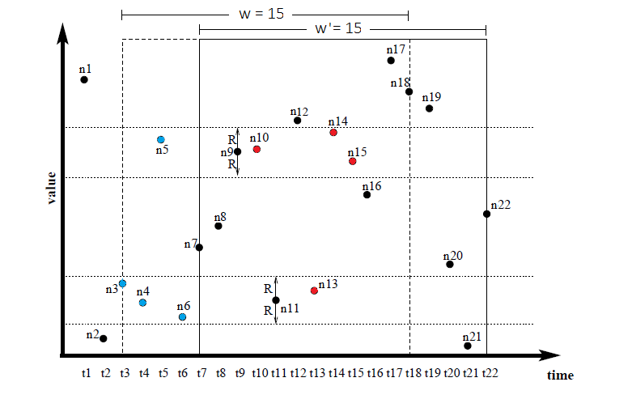
Definition
W : window size
R : range
Neighbours
- preceding Neighbours •
- succeeding neighbors •
k - value
Outlier : pre_neig + succ_neig < k
Inlier : pre_neig + succ_neig >= k
- Safe inlier : succ_neig >= k
k = 3

Slide 5
Definition
Node, n
- n.id identifier
- n.obj value
- n.count_after number of succeeding neighbors
- n.nn_before list of preceding Neighbours
ISB (Index Stream Buffer) Data structure store all node in windows, queue-like.

Slide 6
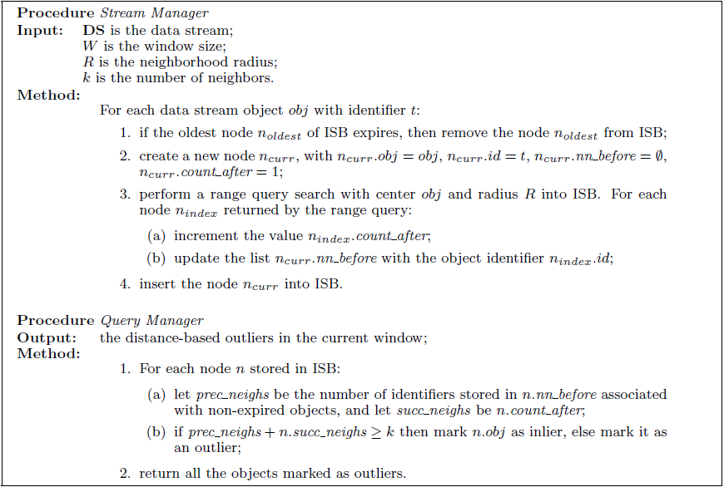
Exact Algorithm

Slide 7
Approximation Algorithm
Algorithms for Detecting Distance-Based Outliers

Slide 8

Definition
Node, n
- n.id
- n.obj
- n.count_after
- n.nn_before > n.fract_before =$\frac{ \text{coun}\text{t}\text{_}\text{before} }{\text{safe}\text{_}\text{inliers}}$
ρ safe_inlier <= ρw

Slide 9
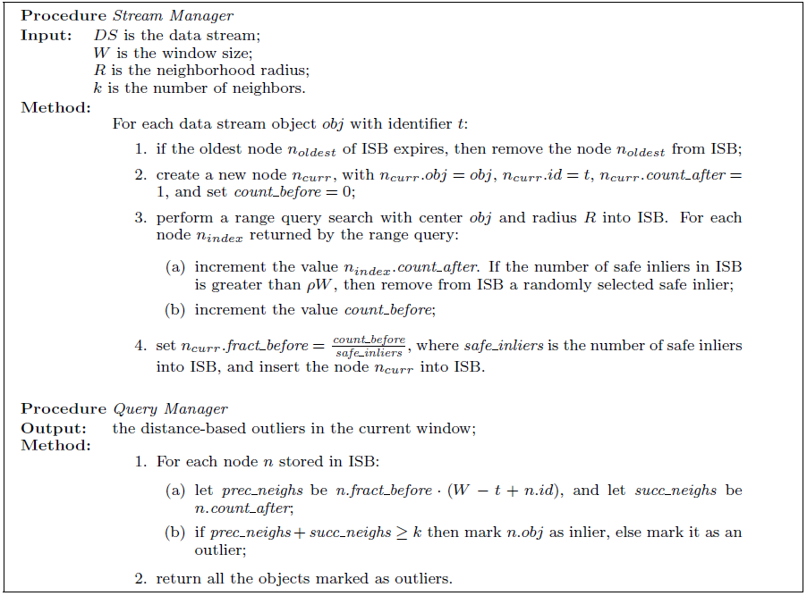
Approximation Algorithm

Slide 10
Experiment
Algorithms for Detecting Distance-Based Outliers

Slide 11
Experiment
Synthetic data
Real data

Slide 12
Synthetic data
Single Dimension
Random mixture of three Gaussian distributions 35000 records with,
Mean = 50, SD = 2.5; 32500 records
Mean = 30, SD = 2.5; 125 records, (labelled as outlier)
Mean = 70, SD = 2.5; 125 records, (labelled as outlier)

Slide 13
Synthetic data, w
Fixed: R = 5 K = 75 ρ = 0.05
Various: W = 1000, 3000, 5000, 7000, 100000
 | Exact Algorithm |  |  |  |  | Approximate Algorithm
w: | 1000 | 3000 | 5000 | 7000 | 10000 | 1000 | 3000 | 5000 | 7000 | 10000
running time (min:sec) | 60.33 | 239.07 | 451.37 | 765.72 | 1149.17 | 10.07 | 19.95 | 25.95 | 38.52 | 48.23
number of node in ISB | 1000 | 3000 | 5000 | 7000 | 10000 | 168 | 319 | 461 | 616 | 830
number of outlier detected | 275 | 253 | 250 | 250 | 250 | 269 | 253 | 250 | 250 | 249
error | 10.00% | 1.20% | 0.00% | 0.00% | 0.00% | 7.60% | 1.20% | 0.00% | 0.00% | 0.40%
precision | 90.91% | 98.81% | 100.00% | 100.00% | 100.00% | 92.94% | 98.81% | 100.00% | 100.00% | 100.00%
recall | 100.00% | 100.00% | 100.00% | 100.00% | 100.00% | 100.00% | 100.00% | 100.00% | 100.00% | 99.60%

Slide 14
Synthetic data, w

Slide 15
Synthetic data, w
 | error
w | exact | approx
1000 | 10.00% | 7.60%
2000 | 2.80% | 2.40%
3000 | 1.20% | 1.20%
4000 | 0.80% | 0.00%
5000 | 0.00% | 0.00%
6000 | 0.00% | 0.00%
7000 | 0.00% | 0.00%
8000 | 0.00% | 0.40%
9000 | 0.00% | 0.40%
10000 | 0.00% | 0.40%

Slide 16
Synthetic data, w

Slide 17
Synthetic data, r
Fixed: w = 5000 K = 75 ρ = 0.05
Various: r = 2.5, 3.75, 5, 6.25, 7.5
 | Exact Algorithm |  |  |  |  | Approximate Algorithm
r: | 2.5 | 3.75 | 5 | 6.25 | 7.5 | 2.5 | 3.75 | 5 | 6.25 | 7.5
running time (min:sec) | 312.72 | 387.87 | 451.37 | 492.91 | 539.09 | 44.17 | 32.79 | 25.95 | 25.59 | 30.52
number of node in ISB | 5000 | 5000 | 5000 | 5000 | 5000 | 879 | 611 | 461 | 391 | 372
number of outlier detected | 312 | 258 | 250 | 250 | 250 | 300 | 257 | 250 | 248 | 247
error | 24.80% | 3.20% | 0.00% | 0.00% | 0.00% | 20.00% | 2.80% | 0.00% | 0.80% | 1.20%
precision | 80.13% | 96.90% | 100.00% | 100.00% | 100.00% | 83.33% | 97.28% | 100.00% | 100.00% | 100.00%
recall | 100.00% | 100.00% | 100.00% | 100.00% | 100.00% | 100.00% | 100.00% | 100.00% | 99.20% | 98.80%

Slide 18
Synthetic data, r

Slide 19
Synthetic data, r

Slide 20
Synthetic data, r

Slide 21
Synthetic data, k
Fixed: w = 5000 r = 5 ρ = 0.05
Various: k = 13, 25, 50, 75, 88
 | Exact Algorithm |  |  |  |  | Approximate Algorithm
k: | 13 | 25 | 50 | 75 | 88 | 13 | 25 | 50 | 75 | 88
running time (min:sec) | 465.74 | 441.37 | 459.58 | 451.37 | 441.35 | 24.13 | 23.38 | 26.01 | 25.95 | 27.92
number of node in ISB | 5000 | 5000 | 5000 | 5000 | 5000 | 384 | 399 | 430 | 461 | 467
number of outlier detected | 186 | 250 | 250 | 250 | 251 | 120 | 249 | 249 | 250 | 250
error | 25.60% | 0.00% | 0.00% | 0.00% | 0.40% | 52.00% | 0.40% | 0.40% | 0.00% | 0.00%
precision | 100.00% | 100.00% | 100.00% | 100.00% | 99.60% | 100.00% | 100.00% | 100.00% | 100.00% | 100.00%
recall | 74.40% | 100.00% | 100.00% | 100.00% | 100.00% | 48.00% | 99.60% | 99.60% | 100.00% | 100.00%

Slide 22
Synthetic data, k

Slide 23
Synthetic data, k

Slide 24
Synthetic data, ρ
Fixed: w = 5000 r = 5 k = 75
Various: ρ = 13, 25, 50, 75, 88
 | Exact Algorithm | Approximate Algorithm
ρ: | - | 0 | 0.025 | 0.05 | 0.075 | 0.1
running time (sec) | 477.86 | 6.57 | 18.33 | 25.95 | 36.69 | 45.70
number of node in ISB | 5000 | 136 | 306 | 461 | 606 | 750
number of outlier detected | 250 | 30138 | 250 | 250 | 250 | 250
error | 0.00% | 11955.20% | 0.00% | 0.00% | 0.00% | 0.00%
precision | 100.00% | 0.83% | 100.00% | 100.00% | 100.00% | 100.00%
recall | 100.00% | 100.00% | 100.00% | 100.00% | 100.00% | 100.00%

Slide 25
Synthetic data, ρ

Slide 26
Synthetic data, ρ

Slide 27
Recommend
W 5000 (15% of records)
Big enough to capture the data trends,
Small enough for acceptable running time
R 5 2 x SD
k 75 1.5% of w

Slide 28
Real data
From Activity Recognition in the Home Setting
Consists of data from temperature and humidity sensor (2 Dimensions)
Contain 18914 records

Slide 29
Temperature
Analysis: mean = 27.50, SD = 2.18
w = 2700 r = 4.4 k = 48 ρ = 0.05
 | Exact Algorithm | Approximate Algorithm
running time (sec) | 111.88 | 16.55
number of node in ISB | 2700 | 330
number of outlier detected | 125 | 115
Error* | - | 8.00%
Precision* | - | 100.00%
Recall* | - | 92.00%
*Data is unsupervised. Error, precision, and recall calculate by assume Exact algorithm result is correct.

Slide 30
Humidity
Analysis: mean = 45.98, SD = 4.81
w = 2700 r = 9.6 k = 48 ρ = 0.05
 | Exact Algorithm | Approximate Algorithm
running time (sec) | 108.44 | 9.09
number of node in ISB | 2700 | 287
number of outlier detected | 88 | 95
Error* | - | 7.95%
Precision* | - | 92.63%
Recall* | - | 100.00%
*Data is unsupervised. Error, precision, and recall calculate by assume Exact algorithm result is correct.

